Slide 1



Market Basket Analysis: A Powerful Tool for Businesses
Market basket analysis is a data mining technique that helps businesses understand the relationship between products purchased by customers. It's like deciphering a customer's shopping cart to discover hidden patterns and connections.
A.UMAR(192210097)
P.TEJASURYAPRAKASH(192211810)

Slide 2

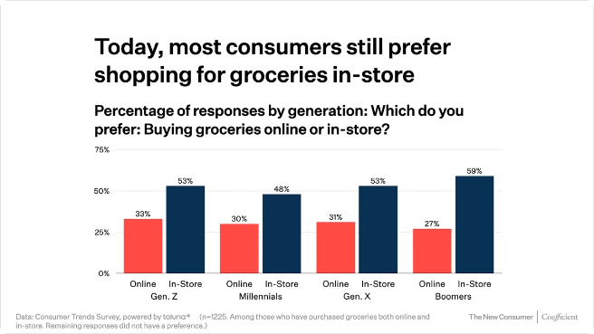
Understanding Customer Purchasing Patterns
1
Frequent Combinations
2
Associations and Correlations
Identify products often bought together, revealing customer preferences and shopping habits.
Discover statistically significant relationships between products, highlighting potential dependencies.
3
Product Affinity
4
Customer Segmentation
Analyze how products influence each other's purchase likelihood, providing insights into customer decision-making.
Group customers based on their purchasing patterns, enabling targeted marketing campaigns.

Slide 3
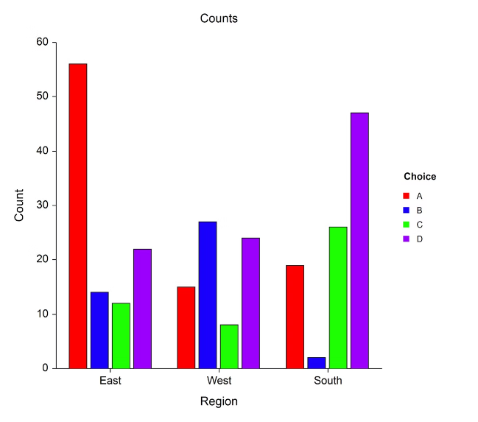
Identifying Associations and Correlations
Association Rule
Description
If a customer buys bread, they are likely to buy milk.
A strong correlation suggests that bread and milk are frequently purchased together.
Customers who purchase coffee also tend to buy sugar.
An association indicates a common buying pattern, suggesting a relationship between coffee and sugar.

Slide 4
Association Rule
Antecedent
Consequent
Confidence and Lift
The antecedent represents the product or set of products that trigger the rule
The consequent represents the product or set of products likely to be purchased given the antecedent
Confidence measures the probability of the consequent being purchased given the antecedent. Lift measures the strength of the association rule compared to chance

Slide 5

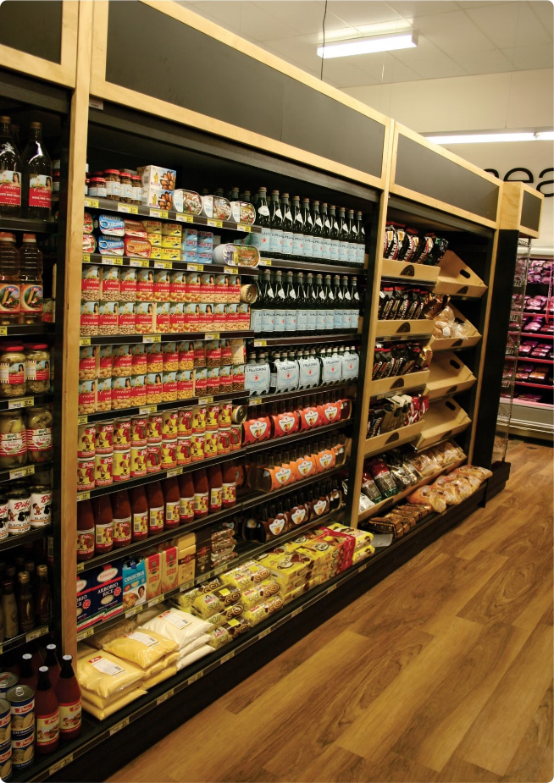



Optimizing Product Placement and Merchandising
Product Placement
Place related products together, maximizing cross-selling opportunities.
Shelf Space Allocation
Optimize shelf space based on product popularity and profitability.
Merchandising Strategies
Implement effective merchandising techniques to influence customer purchasing decisions.

Slide 6





Enhancing Cross-Selling and Upselling Strategies
Cross-Selling
Offer complementary products during checkout, increasing average transaction value.
Upselling
Suggest premium or higher-value alternatives to increase sales revenue.
Personalized Promotions
Offer targeted promotions based on customer purchase history, driving engagement.

Slide 7

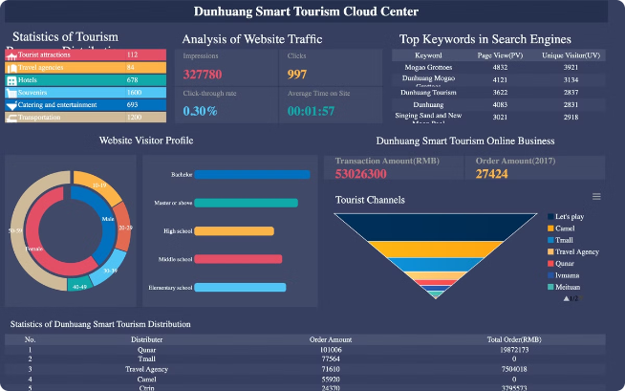
Leveraging Data-Driven Insights for Targeted Marketing
1
Customer Segmentation
Identify customer groups based on their purchasing patterns, enabling personalized marketing.
2
Targeted Marketing Campaigns
Develop tailored marketing messages and promotions for specific customer segments.
3
Campaign Optimization
Analyze campaign performance and adjust strategies based on data-driven insights.

Slide 8


Conclusion and Key Takeaways
Market basket analysis provides invaluable insights into customer behavior, enabling businesses to optimize operations, enhance marketing strategies, and boost profitability.

